Slide 1

E-Commerce Dataset
By: Jose Pablo Bremer Ortega
Last Updated: 09/06/22

Slide 2

Index
Title
Index
Question 1
Question 1 visualization
Question 2
Question 2 queries
Question 3
Question 3 visualization
Question 4
Question 4 visualization

Slide 3
How Many people buy in bulge and how does it compare to regular buyers?
After analyzing the dataset, we decided to identify all transactions that had 10 or more in quantity were “Bulge Sales”, below 10 were “Regular Buys” and negatives were “Cancelled”.
After this we figured out that bulge sales show a big difference compared to regular sales throughout 2019, showing an average difference of 311%.

Slide 4
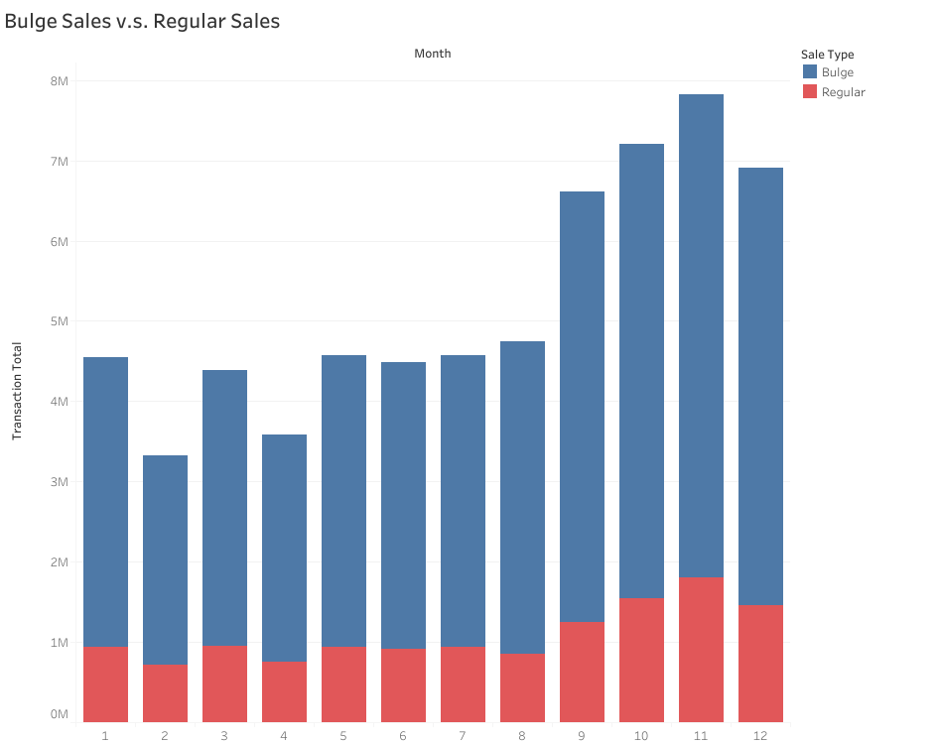

Slide 5
Which were our best and worse months?
We measured the months by average in sales.
Our 3 best months were October, November, and December.
Our 3 worst months were January, February, and March.

Slide 6
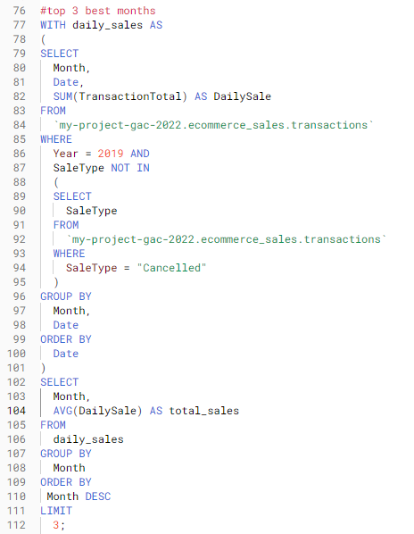
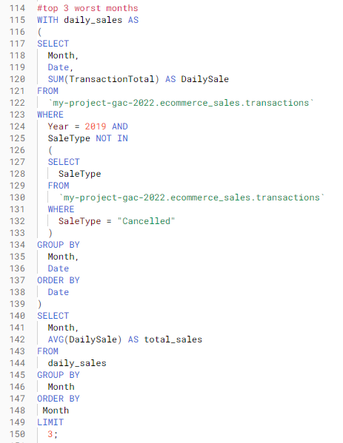

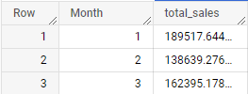

Slide 7
which weekdays should have an added discount in January?
We measured the average sales of the last 2 months and the past January.
Then we grouped the results in weekdays.
Monday and Friday turned out to be the best performing in those months.

Slide 8
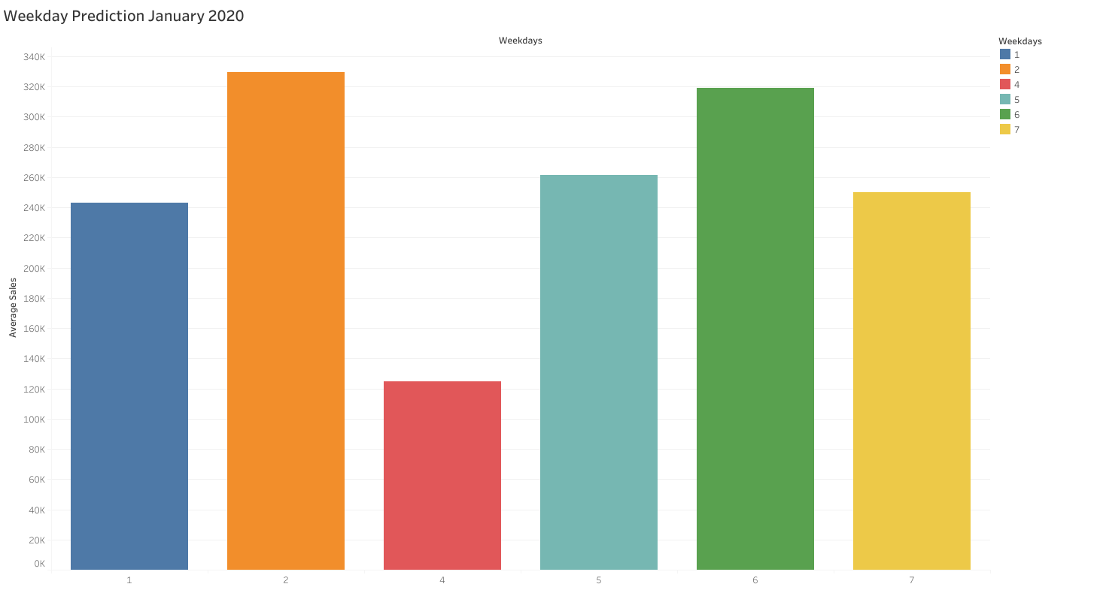

Slide 9
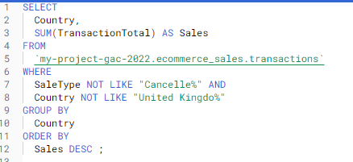
Should we target marketing campaigns to countries that performed well in the last year? What 3 countries other than the UK and why?
Here we just calculated the sum of every country and excluded the UK from the results.
The top 3 were the Netherlands, Ireland, and Germany but France was really close to tying for third so it might be good to keep an eye on France too.

Slide 10
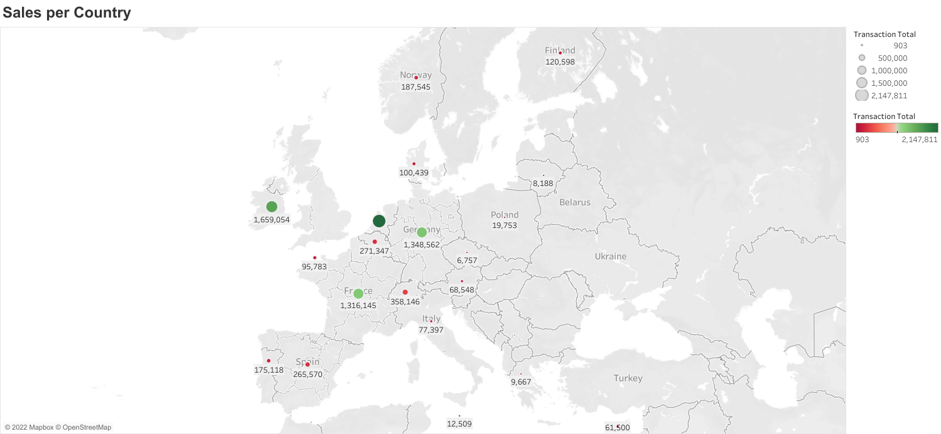

Slide 11

Thank you for your time.

